Slide 1
Bangladesh Geography

Slide 2
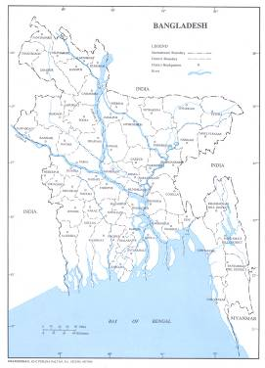
Country Profile - Bangladesh
Area : 147,570 sq. km
Population : 144 million
Population Density : 976 persons per sq. km
Location : In the West, North & North-East: India
In the South East: Myanmar
In the South: Bay of Bengal
Average Height : 10m above sea level.
Capital City : Dhaka
Language : Bengali
Currency : Taka (1 US$ = 68 Taka)
Government : Parliamentary Form
Main River : The Padma, the Jamuna & the Meghna
Climate : Sub-tropical
Temperature : 7.22 - 22.77 ⁰C in winter & 23.88 - 38.5 ⁰C in summer
Average Rainfall : Annually 1429 to 4338 mm
Main Export : Jute, Tea, Garments, Frozen Fish etc.

Slide 3
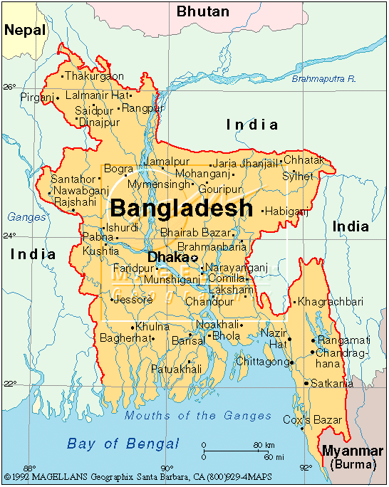
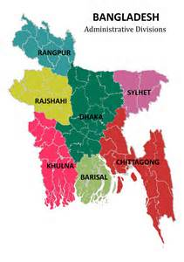
Geographical Location:
Bangladesh extends from 20°34’N to 26°38’N latitude and from 88°01’E to 92°41’E longitude. Except the hilly southeast, most of the country is a low-lying plain land. It is surrounded by the Assam Hills in the east, the Meghalaya Plateau in the north, the lofty Himalayas lying farther to the north. To its south lies the Bay of Bengal and to the west lie the plain land of West Bengal and the vast tract of the Gangetic Plain.
The total land area: 147, 570 sq km.
Total population: 163 million -2013
Population density: 1174.33 per sq. Km.
Ad. Division: Seven Divisions.
Climate: Monsoon dominating tropical.

Slide 4
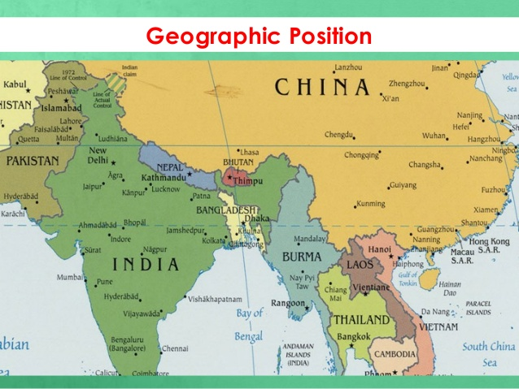

Slide 16
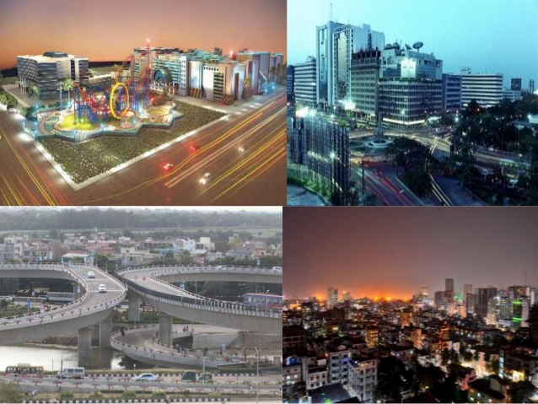

Slide 17
